Slide 1
Status of Autonomy Implementation

Slide 2
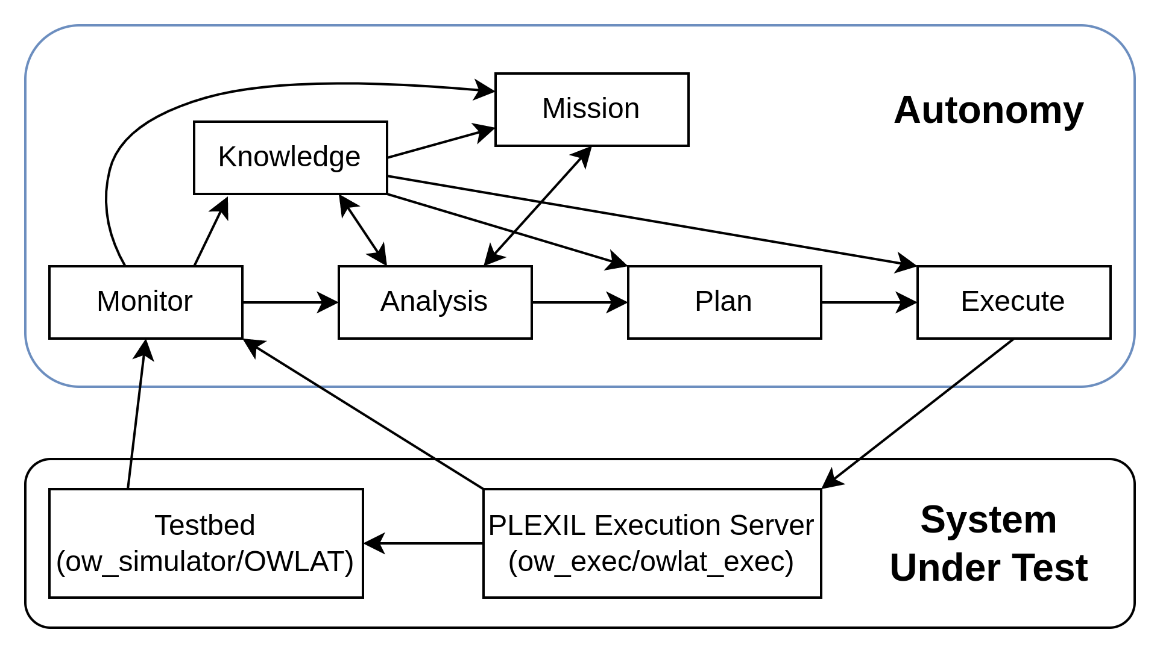
Autonomy Design - Hierarchical Mission Control
Hierarchical Mission Control
Mission
Task 1
Plan 1
Operation 1
Operation 2
…
Plan 2
…
Task 2
…
Role of Each Component
Mission node:determine which task to run next. (Causal Model?)
Analysis: determine if an adaptation is needed and what it is.
Plan: task planning by prism model
Execute: plan translator, fault clear
Knowledge: knowledge maintenance

Slide 3
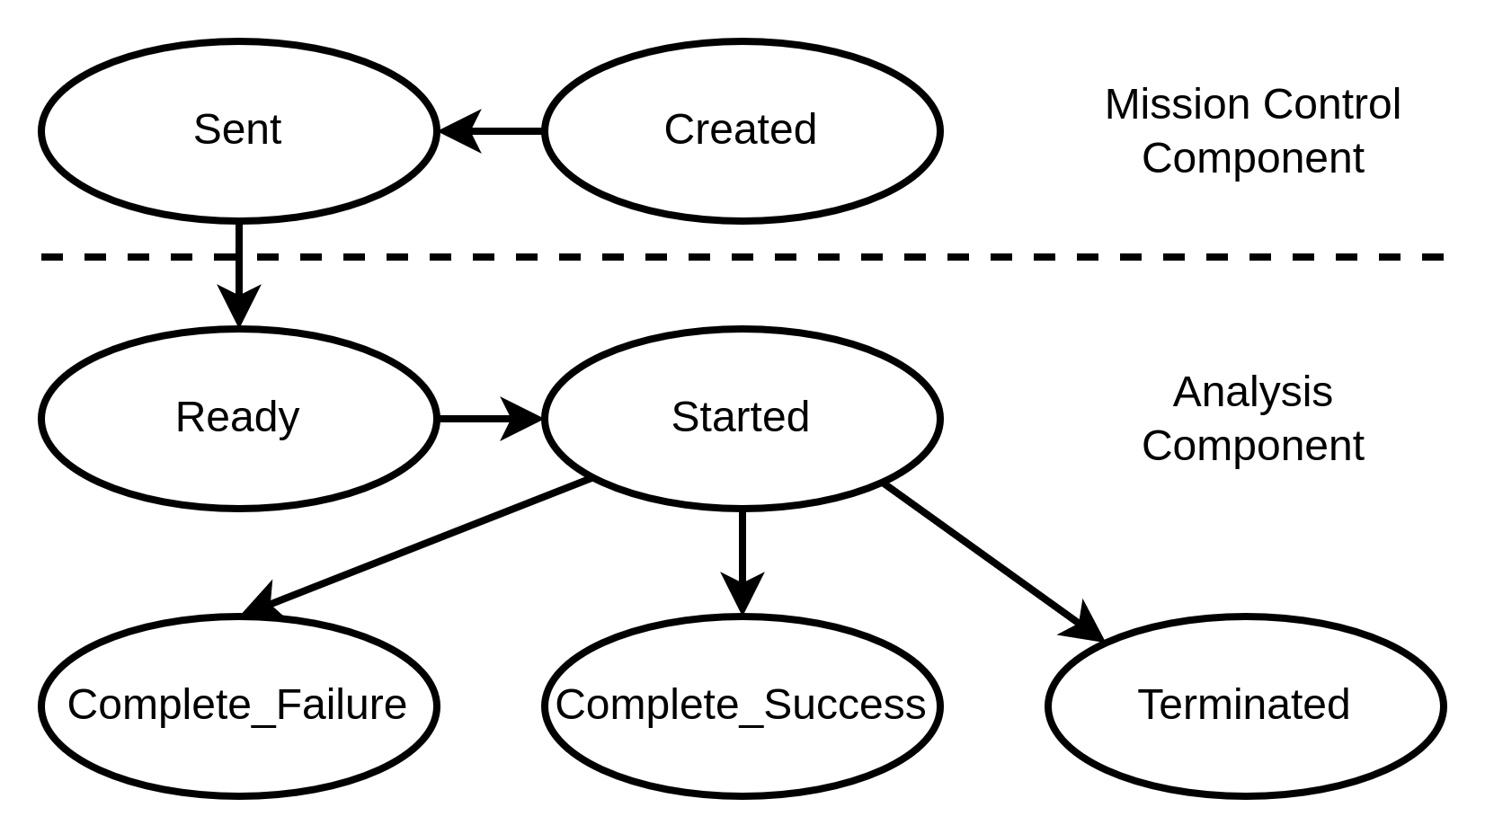
Responsible Entities for monitoring the statuses
Mission Status:
it is monitored by Mission Control.
To determine it, it may need to collect information from Monitor, Knowledge and Analysis.
In current implementation, it reports the status by only checking the task status returned by Analysis.
Task Status:
it is monitored by Analysis. By design, it is determined by collectively checking the completeness of the objective(s) of the task, available resources and constraints.
Current implementation realizes a simplified version without a consideration of available resources and constraints.
The transition diagram of task status.

Slide 4
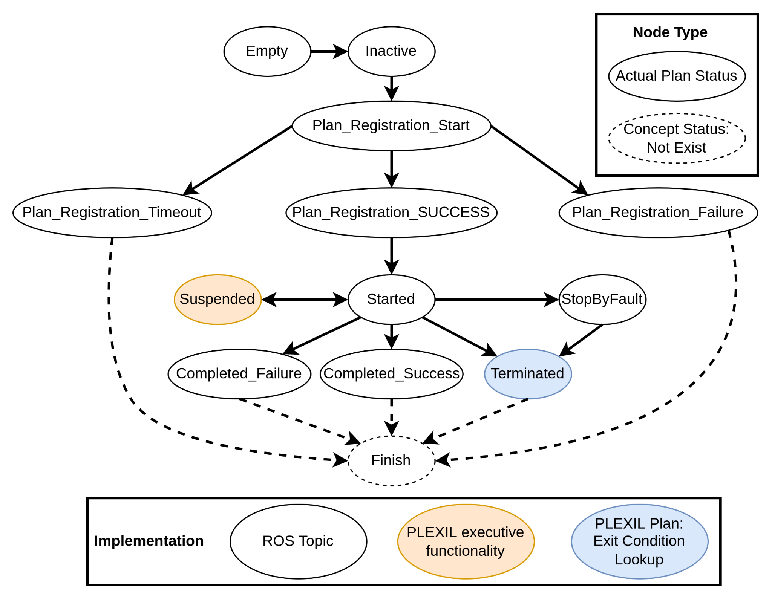
Responsible Entities for monitoring the statuses
Plan Status:
it is monitored by a component (ow_exec or owlat_exec ROS node) in the PLEXIL Execution Engine, whose role is to maintain the PLEXIL executive and arriving PLEXIL plans.
The Plan Status here is somehow a high-level state of a plan but does not have details about how each operation goes.
The transition diagram of plan status

Slide 5
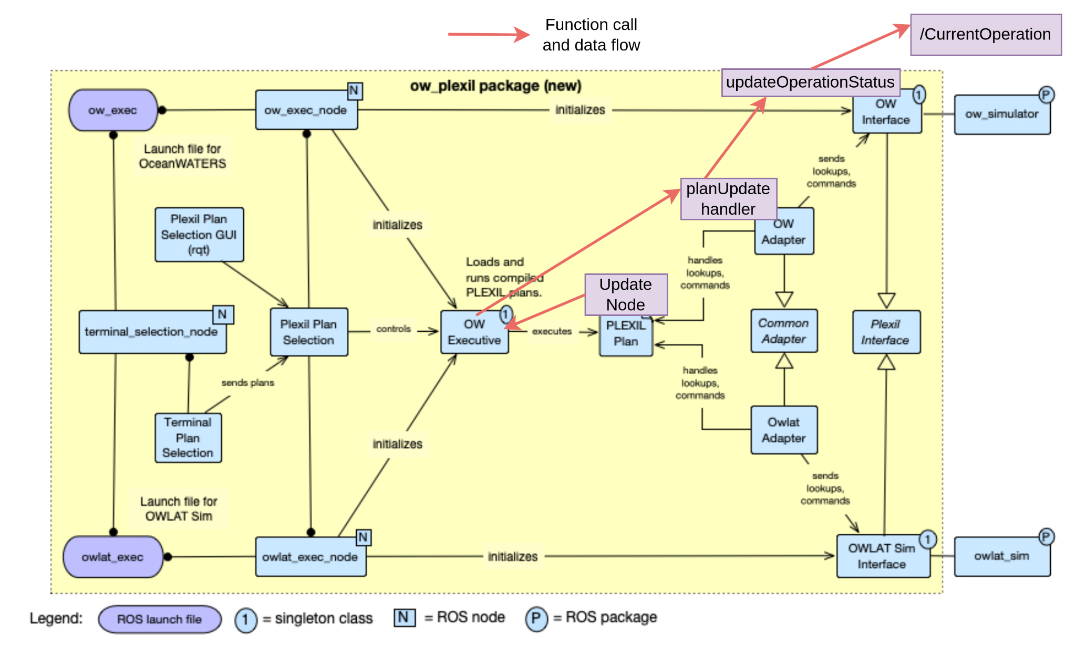
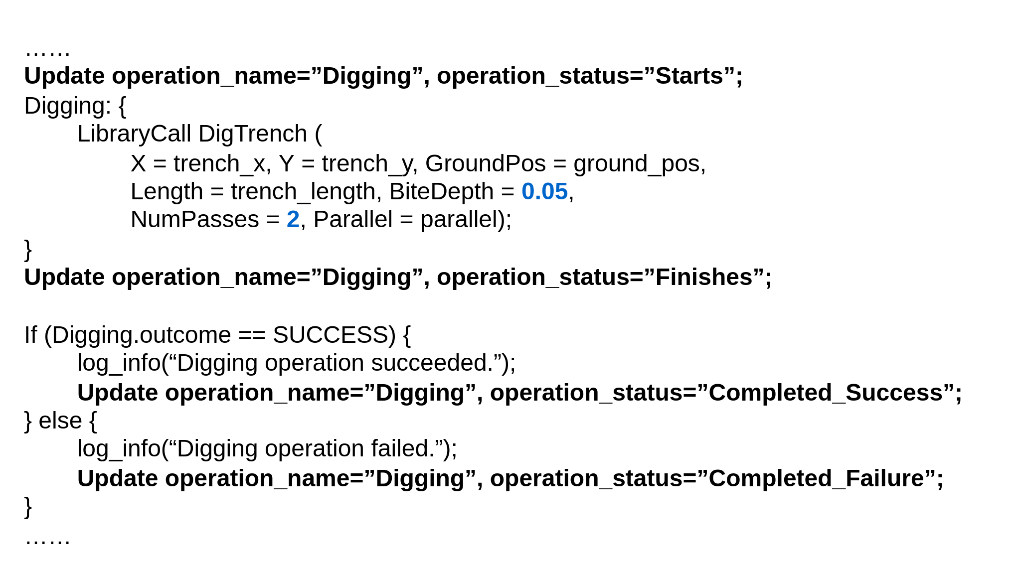
Responsible Entities for monitoring the statuses
Operation Status: it is handled by PLEXIL Executive and the designers of PLEXIL plan templates. One task has one PLEXIL plan template. The template is designed by injecting PLEXIL Update nodes in interesting points in a PLEXIL plan. In the runtime, the interested information could be communicated from the PLEXIL executive to the autonomy through the PLEXIL Update node and a ROS topic (“/CurrentOperation”).
Support PLEXIL Update node in the ow_plexil package
An example of using Update nodes in a PLEXIL plan

Slide 6
Role of each component
Mission Control: monitor the status of the mission, decide the next task
MAPE-K
Analysis: adaptation analysis for the task
Plan: task planning using Prism models
Execute: plan translation + PLEXIL plan compilation, send fault clear signal
Knowledge: update machine-learning models and runtime info
Monitor: relay interesting info or determine if some interesting properties changes
Fault Management: inject or clear fault by using dynamci_configuration package

Slide 7
Mission Control Component
What
Parse a mission specification
Monitor the status of the mission
Decide the next task
Monitor the status of the current task
Request to Analysis Component terminate the current task
Request Analysis Component to do a new task
How
Status of the mission: causal model? (# of number tasks completed)
Determination of the next task - causal model? (the next task in sequence)
Status of the current task: subscribe to a ROS topic
Requests to Analysis Component: publish ROS topics

Slide 8
Analysis Component
What:
Queue a new task sent from Mission Control Component
Starts, terminate and complete the current task
Monitor the status of the current task
Adaptation event trigger analysis
Request to Knowledge component to update machine learning models
Request to Knowledge component update the run-time information (part of knowledge)
Request to Plan component to create a new plan for the current task
How:
Requests to Knowledge component: ROS services + Integration of machine-learning models into the model-update Python package
Adaptation trigger analysis: condition checking inside Analysis component
Request to Plan component: publish to ROS topic

Slide 9
Knowledge Component
What:
Maintain machine learning models
Maintain runtime information
Knowledge update service
How:
Retrain models using integrated python package
Create & update a runtime info file for a task
Knowledge update service: ROS services

Slide 10
Plan Component
What:
Listen to the request from Analysis component
Create a plan for the current task
Maintain the current runtime information
Pass adaptation instructions to Execute component
How:
Subscribe to a ROS topic, /Analysis/AdaptationInstruction
Load the corresponding runtime information file
Create a plan for the current task:
automatically create a PRISM model
Query the PRISM model to get the prism policy
Extract a plan from the policy
Send adaptation instructions to Execute component: ADD, TERMINATE

Slide 11
Execute Component
What
Listen to the execution request from Plan component for adaptation instructions
Translate the plan output by Prism model to a PLEXIL plan
Send to the PLEXIL plan to OW PLEXIL executive engine to run
Send execution instructions to OW PLEXIL executive engine
How
Plan Translation: Use runtime info and the plan by Prism model to fill a plan template for a task
Terminate instruction: In the plan template, add a PLEXIL Exit condition that constantly checks the value of a ROS topic, /autonomy/terminate.

Slide 12
Monitor Component
What
Monitor important system properties: arm fault (e.g., force, torque, battery level)
Monitor interesting environment conditions: vibration level (e.g., radiation level)
Monitor the status of the current operation: e.g., Grind, Deliver
Send information to Knowledge, Analysis and Mission Control components
Determine when to send out information
How
Monitoring actions: subscribe to ROS topics
Message Sending actions: publish to ROS topics
Decision on when to send:
some type of info is directly related: e.g. the status of the current operation
while others are triggered by some events: e.g. has_arm_fault, has_a_earthquake

Slide 13
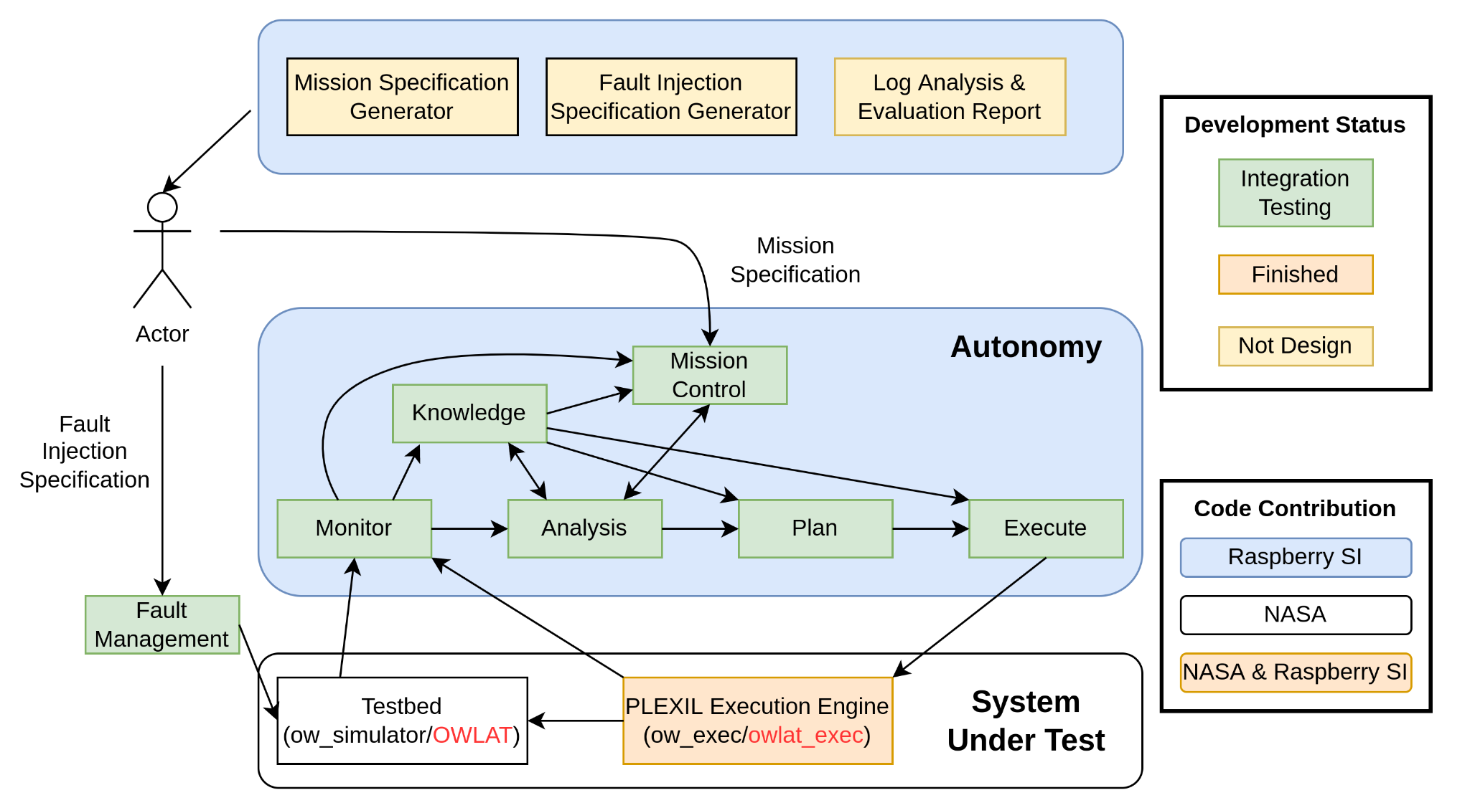
Current Implementation & Evaluation Infrastructure

Slide 14
Enhancement & Extension
Transition to ow_simulator release 9
Transition to OWLAT: plan translator, plan template, fault injection
New task: new plan template, new prism model
Intelligence in Mission Control Component
More sophisticated Fault Management if necessary

Slide 16
Adaptation Cases
case 1: digging fails due to an incorrectly estimated excavation probability
case 2: the beliefs of supporting machine-learning models drop below predefined
case 3: surface vibration caused by earthquake
case 4: an arm fault is detected during executing a plan for excavation task
case 5: a manual plan sent from the Earth center
case 6: has a new task and need to terminate the current task
case 7: the current task finishes and has a new task needs

Slide 17
Case 1: digging fails due to an incorrectly estimated excavation probability
Monitoring Information:
status of digging operation
arm fault signal
Adaptation Trigger:
when an arm fault signal is notified during digging operation (starts but not finishes), it indicates an digging failure.
Adaptation:
Unstow the arm
Remove the current excavation location and synthesize a new plan with the rest locations
Notes:
(simulate the failure of digging by checking excavation probability p against a random number p' between 0 and 1. And trigger an arm faul if p' > p since it indicates a digging failure. The checking will only be checked after the digging operation starts. Currently, the checking is performed in the analysis component. Arm fault can have other semantics in other cases)

Slide 18
Case 2: the beliefs of supporting machine-learning models drop below predefined
Monitoring Information
the number of digging failures due to incorrectly estimated excavation probability
Adaptation Trigger:
number of failure == 2, update the excavation probability model
number of failure == 3, update both excavation probability model and science model.
That is, a new list of locations will be provided.
Adaptation:
Unstow the arm (this is specific for the excavation scenario)
Update models
Update runtime information (the lists of locations for excavation scenario)
Synthesize a new plan

Slide 19
Case 3: surface vibration caused by earthquake
Monitoring Information
vibration level
Adaptation Trigger:
vibration level: (a level of 0 is considered as normal and no adaptation is required for it)
level == 1: the terrain has be changed. The models and runtime info need to be updated
Adaptation:
Stop the current plan, unstow the arm
Update models and runtime info and re-planning after the vibration level comes back to 0

Slide 20
Case 4: an arm fault is detected during executing a plan for excavation task
Monitoring Information:
arm fault signal
Adaptation Trigger:
the arm fault is notified
Adaptation:
number of failures will be increased
use the adaptation in either case 1 or case 2 depending on the current number of failures

Slide 21
Case 5: a manual plan sent from the Earth center
Monitoring Information
hasManualPlan
plan name
Adaptation Trigger:
hasManualPlan: True
Adaptation:
Terminate the current plan
Drive the lander to run the manual plan

Slide 22
Case 6: has a new task and need to terminate the current task
Monitoring Information
Has_new_task
terminate_current_task
Adaptation Trigger:
has_new_task: True
terminate_current_task: True
Adaptation:
Terminate the current plan
Move the next task to the current task (update related variables)
Synthesize a plan for the new task and run it

Slide 23
Case 7: the current task finishes and has a new task needs
Monitoring Information
Has_new_task
terminate_current_task
Adaptation Trigger:
has_new_task: True
terminate_current_task: False
Adaptation:
Move the next task to the current task (update related variables)
Synthesize a plan for the new task and run it

Slide 24
The order of adaptation priority
Order Priority Case
0 High case 5 - Manual Plan, hasManualPlan == True
1 High case 3 - Earthquake, vibration level 1
2 High case 6 - Do a new task
3 Medium case 2 - Decreased Belief, # of failures == 3
4 Medium case 2 - Decreased Belief, # of failures == 2
5 Low case 1 - Digging Failure
6 Low case 7 - Starts New Task
Note: case 4 falls through case 1 and case 2.

Slide 25
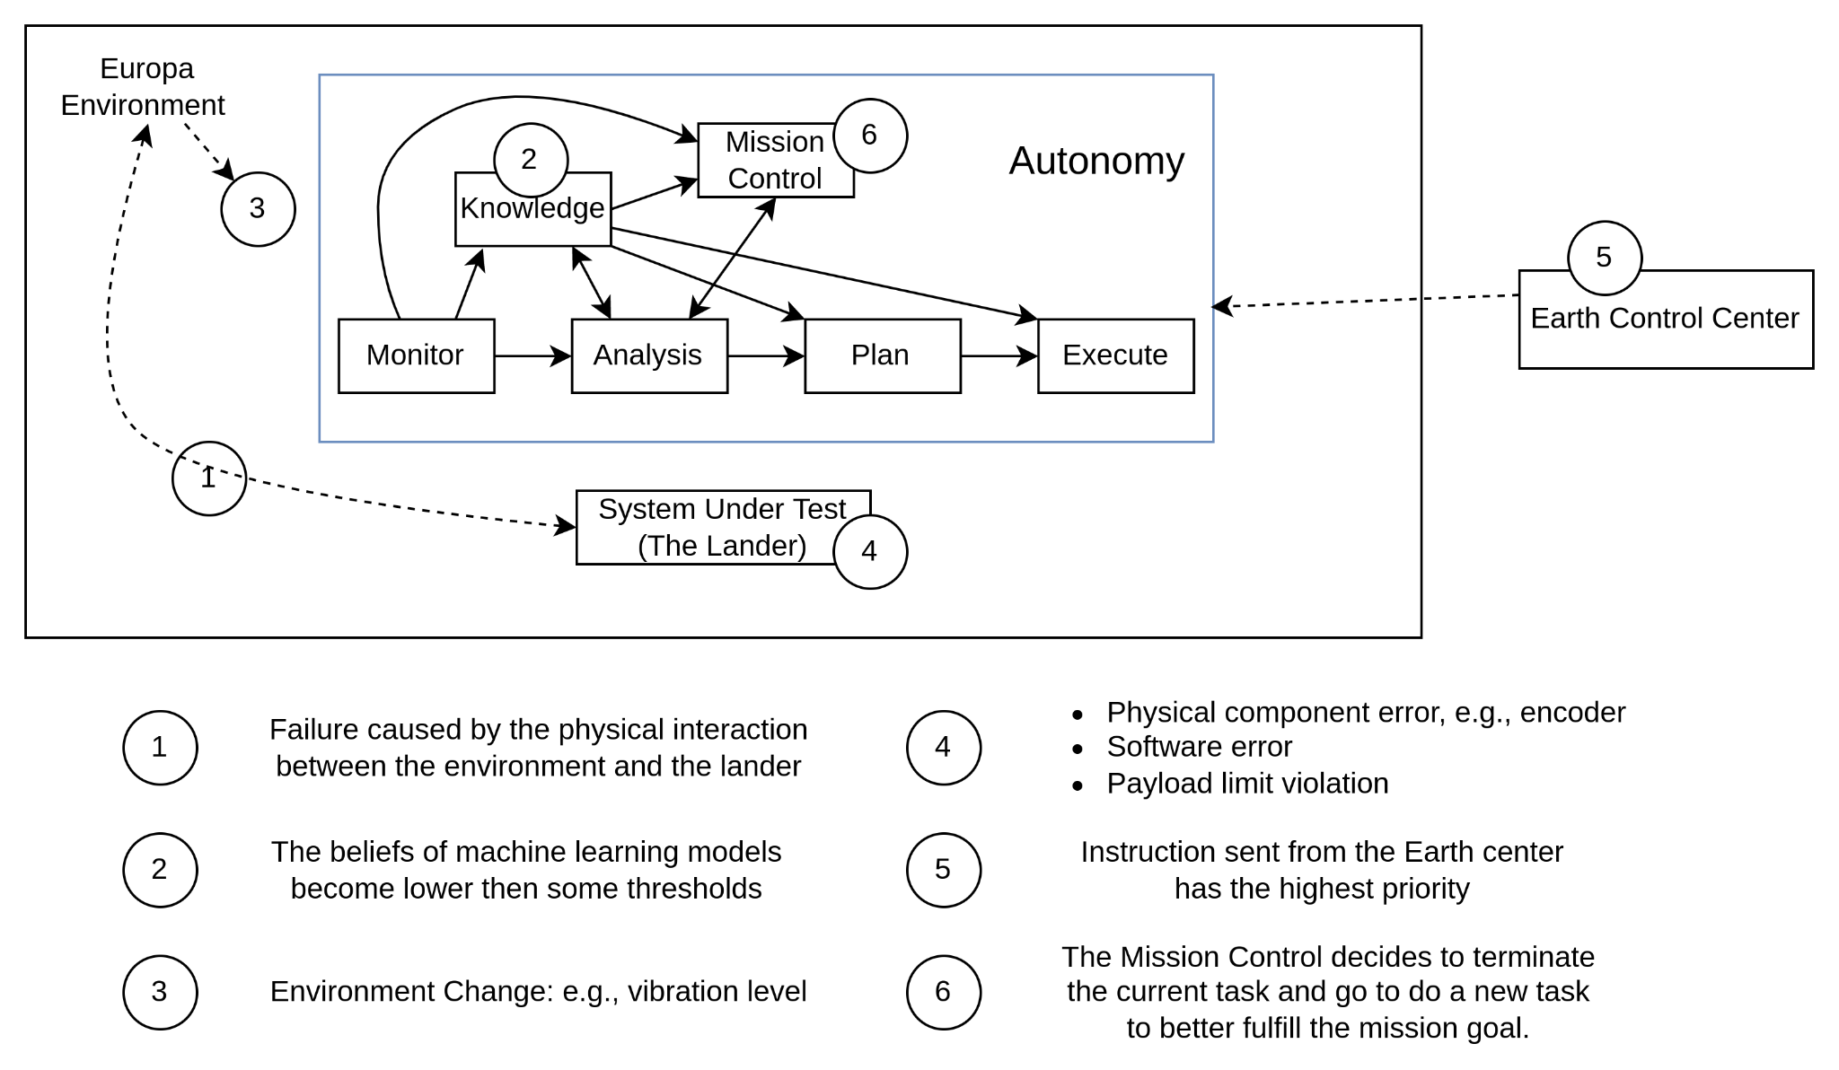
Categorization of the adaptation cases

Slide 26
Build Process
This branch is based on the release 8 of ow_simulator and ow_autonomy.
Follow the "Get Started" in nasa/ow_simulator to install software prerequisites.
Create a catkin workspace mkdirs -p ~/oceanwater_ws/src
pull down the v8-owplexil branch of following repos from nasa-raspberry-si git organization into ~/oceanwater_ws/src.
ow_simulator, ow_autonomy, ow_europa. irg_ope

Slide 27
Build Process - Continue
Pull down ow8-rosnodes branch of nasa-raspberry-si/autonomy into ~/oceanwater_ws/src
Source ROS melodic environment
source /opt/ros/melodic/setup.bash
Build using catkin
catkin build

Slide 28
Run rs_autonomy
Run ow_simulator in one terminal
cd ~/oceanwater_ws && source devel/setup.bash
roslaunch ow europa_terminator.launch
Run ow_autonomy (actually an PLEXIL executive) in another terminal
cd ~/oceanwater_ws && source devel/setup.bash
roslaunch ow_plexil ow_exec.launch

Slide 29
Run rs_autonomy - Continue
Run rs_autonmy in a third terminal
cd ~/oceanwater_ws && source devel/setup.bash
Export three environment variables
export EVALUATION_ROOT_DIR=< evaluation directory >
export OW_PLEXIL_LIB_SOURCE_DIR=< PLEXIL library source directory >
export PLEXIL_LIB_COMPILED_PLAN_DIR=< the direcotry of compiled PLEXIL plan in devel dir >
Run rs_autonomy with an example mission specification file, mission1.txt
roslaunch rs_autonomy rs_autonomy mission_spec_filename:=mission1.txt

Slide 30
Code organization of rs_autonomy
Mission Control node and MAPE-K nodes (except knowledge node)
rs_autonomy/src/mape-k
Knowledge Node and other service nodes
rs_autonomy/script
Python packages for support services in rs_autonomy/src
acknowledgement management (for knowledge node)
prism planning
plan translation
fault management
The organization of evaluation directory
An example of directory structure: rs_autonomy/evaluation
For detailed description, please refer to rs_autonomy/doc/structure_of_evaluation_directory.txt

